Slide 1

Evaluating dsRAG with FinanceBench Dataset
Praneet Kulkarni

Slide 2

Key Innovations in dsRAG
dsRAG is high-performance retrieval engine optimized for unstructured data - financial reports, legal documents, and academic papers - enabling more precise retrieval and answers.
Three Innovations
Semantic Sectioning - Breaks long documents into meaningful sections.
AutoContexting - Automatically enriches chunks with relevant background context.
Relevant Segment Extraction (RSE) - extracts only the most useful segments.

Slide 3
What RSE Does (Relevant Segment Extraction)
Problem:
Answers often span multiple small chunks, making retrieval incomplete.
RSE Solution:
Groups related chunks into cohesive segments.
Provides larger, context-rich passages to the LLM.
Preserves document structure (tables, sections, figures).
Result:
✅ Higher recall
✅ Fewer hallucinations
✅ More precise answers

Slide 4
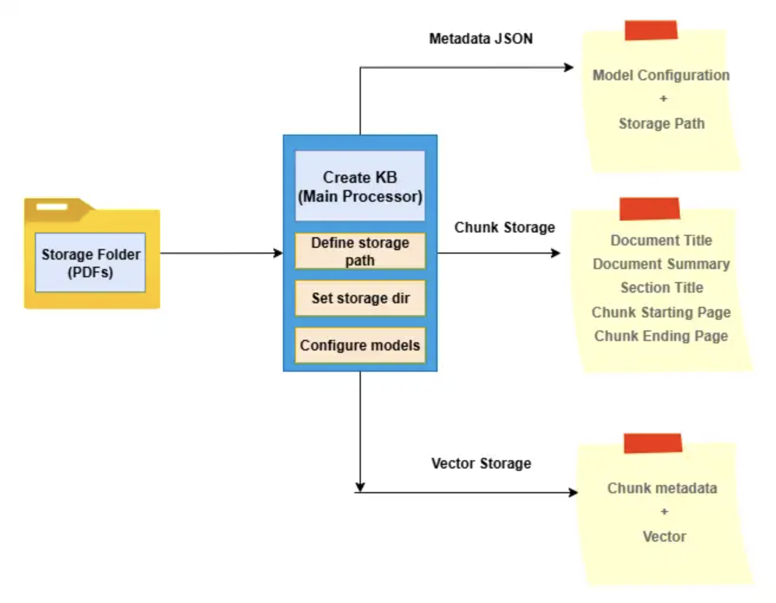
How KB is Formed & Stored
Create_KB:
1. Document Ingestion
2. Semantic Chunking
3. AutoContext Enrichment
4. Embedding Generation
5. Storage

Slide 5
How Inference Works
Query Submitted → user asks a question
Embedding & Matching → query turned into vector, compared with stored vectors
Retrieve Top-k Chunks → most relevant pieces fetched
Reranking → reorder with Cohere/Voyage
RSE (Relevant Segment Extraction) → combine related chunks into segments
LLM Processing → context sent to model (OpenAI, Claude, DeepSeek, etc.)
Answer Generated → grounded, domain-aware, explainable

Slide 6

FinanceBench (Open-Book Financial QA)
What it is
Benchmark to evaluate the reliability and capabilities of large language models (LLMs) when handling finance-specific queries
FinanceBench Open-Source Subset
368 documents - SEC filings and earnings reports across sectors
150 Q&A pairs - curated to stress retrieval + reasoning
Ground-truth answers - each verified against document evidence

Slide 7

Demo: dsRAG on FinanceBench

Slide 8
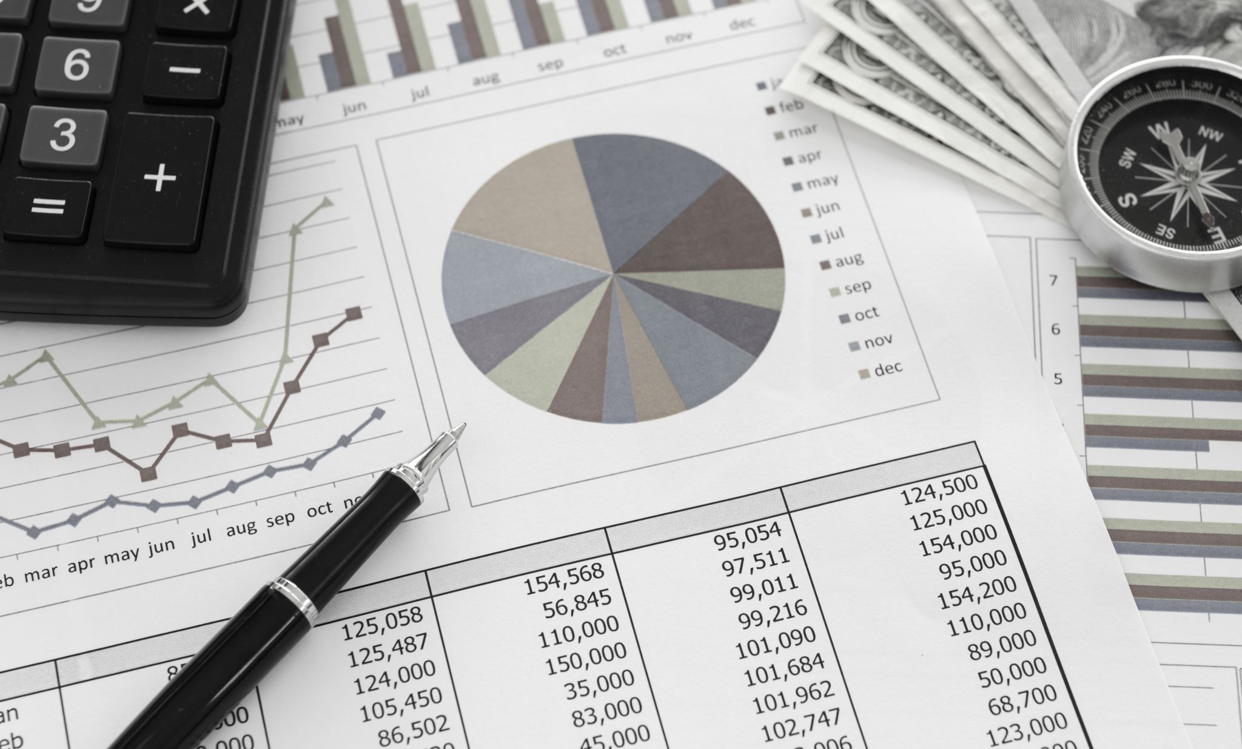
Discussion on Results Spreadsheet

Slide 9
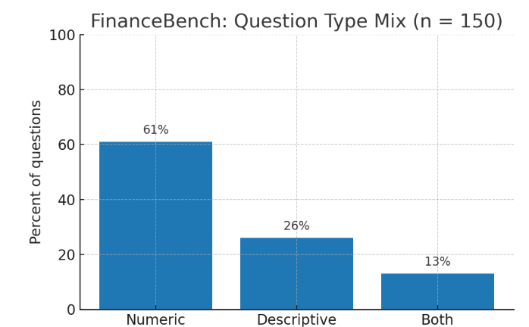
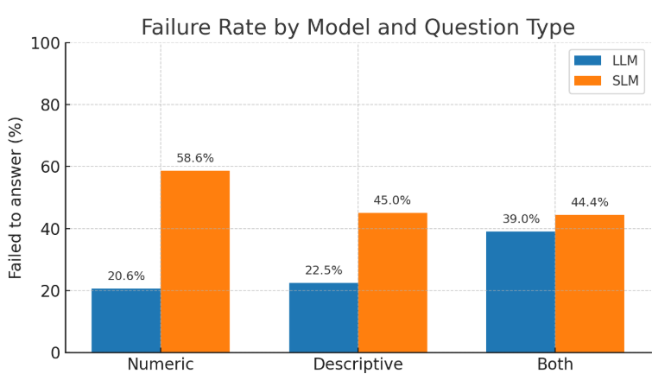
FinanceBench QA Evaluation

Slide 10
FinanceBench QA Evaluation
QA Type | % of Total QAs (FinanceBench) | LLM – Failed (%) | SLM – Failed (%)
Numeric | 61.33% (92) | 20.65% (19) | 58.6% (54)
Descriptive | 26.67% (40) | 22.5% (9) | 45% (18)
Both (N & D) | 12% (18) | 38.89% (7) | 55.5% (10)

Slide 11
Aligned QAs:
Assume that you are a public equities analyst. Answer the following question by primarily using information that is shown in the balance sheet:
What is the year end FY2018 net PPNE for 3M? Answer in USD billions.
Ground truth answer: $8.70B
Model Answer: The year end FY2018 net PPNE for 3M is $8.738B.

Slide 12
Benchmarking error
Q: How much does Pfizer expect to pay to spin off Upjohn? (USD million)
Ground truth answer: 77.78 M
Model answer: Pfizer expects to incur costs of approximately $700 million in connection with separating Upjohn.

Slide 13
Incorrect QA
Q. What is Coca-Cola’s FY2017 ROA?
ROA = FY2017 net income / average total assets (FY2016–FY2017). Round to two decimals.
Ground truth (expected format): 0.01
Model answer (returned): 1.42%

Slide 14
Incorrect QA – continued..
Formula ROA = FY2017 net income ÷ average total assets (FY2016–FY2017)
Inputs (From consolidated income statements)
Shareowners Net income (2017): $1,248M
Total assets: $87,896M (2017), $87,270M (2016)
Compute average assets
87,896+87,270 / 2 = 87,583 M Compute ROA
1,248 / 87,583 = 1.42%
Final
As ratio (2 decimals): 0.01
As percent (2 decimals): 1.42%

Slide 15
Refusal QAs
Q. Roughly how many times has AES Corporation sold its inventory in FY2022? Calculate inventory turnover ratio for the FY2022; if conventional inventory management is not meaningful for the company, then state that and explain why.
Ground truth Answer: AES has converted inventory 9.5 times in FY 2022.
Model Answer: "The provided documents do not contain sufficient information to answer this question."

Slide 16
When model fails to answer?
Multistep numeric calculations and reasoning
Multiple questions in a single QA
References across multiple documents
Prediction-style questions

Slide 17

Conclusion: dsRAG with SLMs
Performance
Accuracy stabilized around 43–45% on FinanceBench.
Struggled with complex reasoning and constrained by smaller context windows.
Advantages
Lower cost and faster inference (avg. ~730–850 sec per run).
Recommendation
The DeepSeek-R1-Distill-Qwen-7B model is a strong candidate for such use cases.
With further fine-tuning and domain adaptation, accuracy could be improved while maintaining efficiency.

Slide 18
Conclusion: dsRAG with LLMs
Performance
On FinanceBench (open-source split), accuracy ≈ 73–76% (~+30 pts vs SLMs).
Advantages
Handles long evidence chains; less reliance on heavy AutoContext.
More robust on complex, mixed (numeric + text) questions.
Bottlenecks
Cost: token-based pricing becomes expensive at full-corpus scale.
Latency: typically, 2–3× slower than SLMs.
Ops limits: API rate caps / token quotas can throttle throughput.
Recommendation
Anthropic Claude 4.0 Sonnet achieved the best accuracy, but at a substantially higher cost.
Best suited for high-stakes, precision-critical use cases, while hybrid deployment with SLMs can help balance cost and performance.

Slide 19
Conclusion: Embeddings & Re-rankers
Embedding models:
text-embedding-3-small → faster & cheaper (1.95$) but weaker retrieval.
text-embedding-3-large → more accurate retrieval (cost 9$) but slower chunking.
all-MiniLM-L12-v2 → A local model offering a strong balance of performance and cost-efficiency.
Re-rankers:
Voyage rerank-2.5 lite gave best balance of accuracy vs. latency.
Cohere models were competitive but slightly slower.

Slide 20
Conclusion: Cost vs. Accuracy Trade-off
SLMs are the cost-efficient option but sacrifice accuracy.
LLMs dominate accuracy but at higher costs and slower runtimes.
Hybrid strategy looks most promising:
Use SLMs with strong re-rankers for bulk/low-priority queries.
Reserve LLMs (Claude, GPT-4o) for complex, high-value financial reasoning tasks.
SLMs are suitable for cost-sensitive or data-secure environments where local deployment is preferred. Else, LLMs looks promising.

Slide 21
Thank you!

